Slide 1
Anti-bullying
Bullying is unkind behaviour by a person or a group, that happens again and again. It is deliberately done (on purpose) to hurt another person, with unkind thoughts, unkind words, unkind hands or unkind feet.

Slide 2
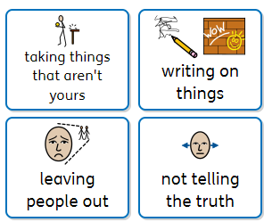
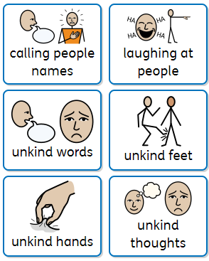
Bullying can look like this…
How would this make you feel?

Slide 3

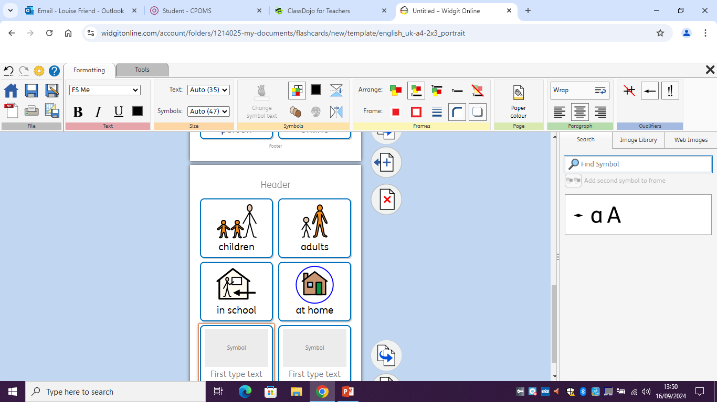
Bullying can happen anywhere, to anyone…

Slide 4
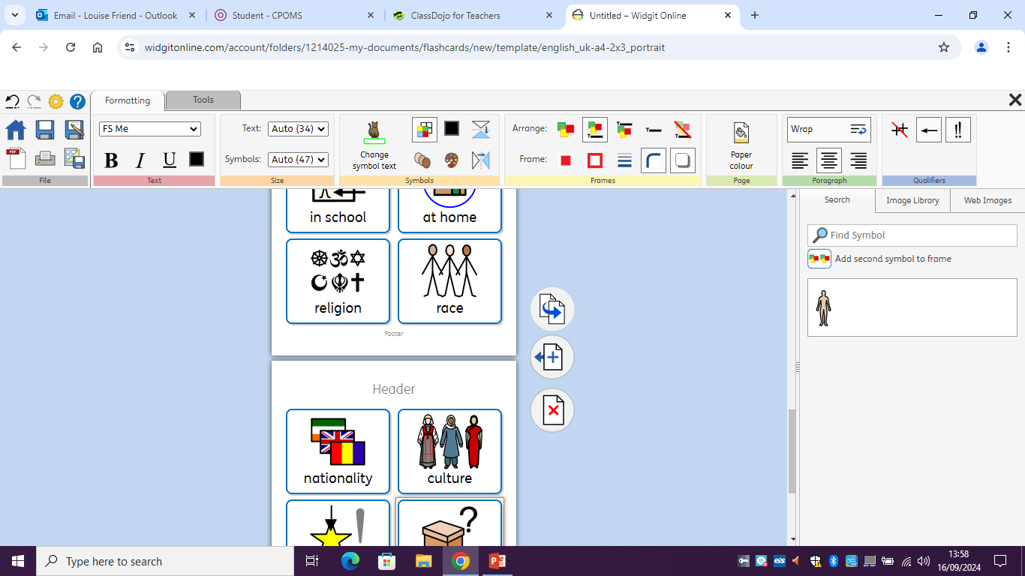
At St Paul’s, we respect and celebrate our differences. Everyone is unique, and that is part of what makes us all special. Sadly, sometimes people are bullied for these differences, or any way they are different.

Slide 5
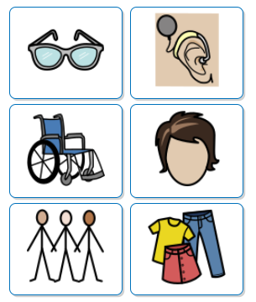
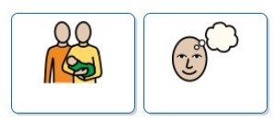
At St Paul’s, we know people can look different to us, need different things to help them learn, come from different families and have different opinions.

Slide 6
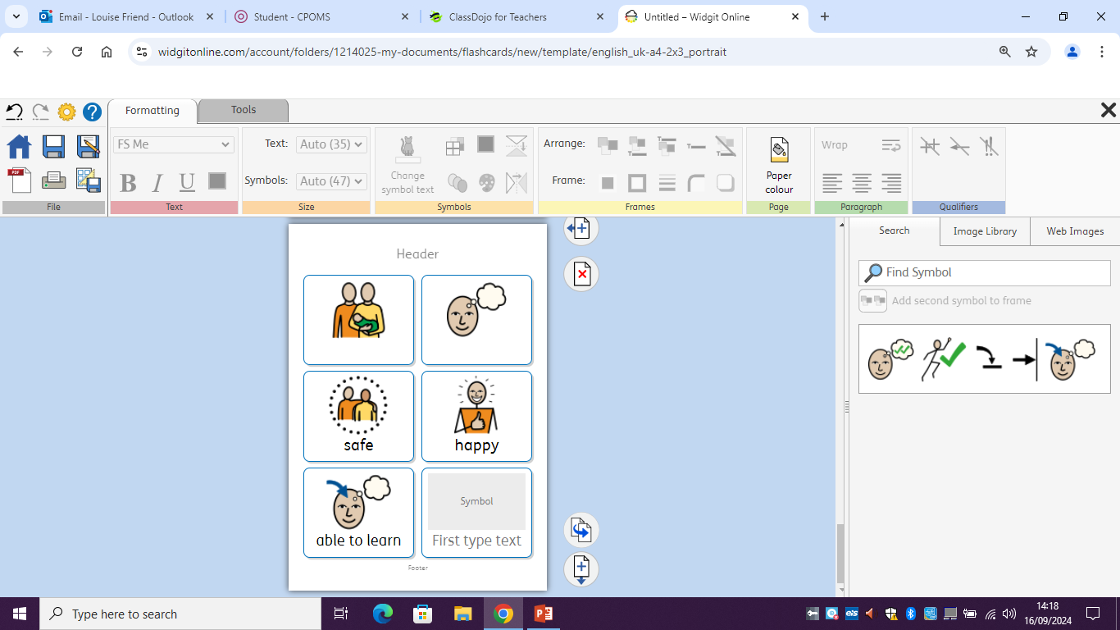
We want everyone to be safe, happy and able to learn.

Slide 7
Everyone in school will help you if you are being bullied.
Talk to your partner-who would you speak to if someone was being unkind to you?

Slide 8

We will listen to you and help you feel better.
Your family will listen and work with school.
The children at St Paul’s will follow the rules and help keep everyone safe, happy and ready to learn.

Slide 9
If someone is being unkind to you, this is what will happen:
Tell a Grown-Up
Grown-Up will speak to the children
Look after you, keep you safe, listen to you
Speak to and listen to everyone involved
Talk to parents if needed
Support for all, and consequences for those involved

Slide 10
If someone is being unkind to you, this is what will happen…
You will be reassured and looked after
You will get to talk to a school grown up
We will help you feel better
We will talk to your parents so they know what happened

Slide 11
If you are being unkind to someone, this is what will happen…
Talk about and listen to what happened
Talk about why you felt this way
Talk about why this needs to change
Talk to your parents so they can help you
Support you to understand what happened
Consequences

Slide 12
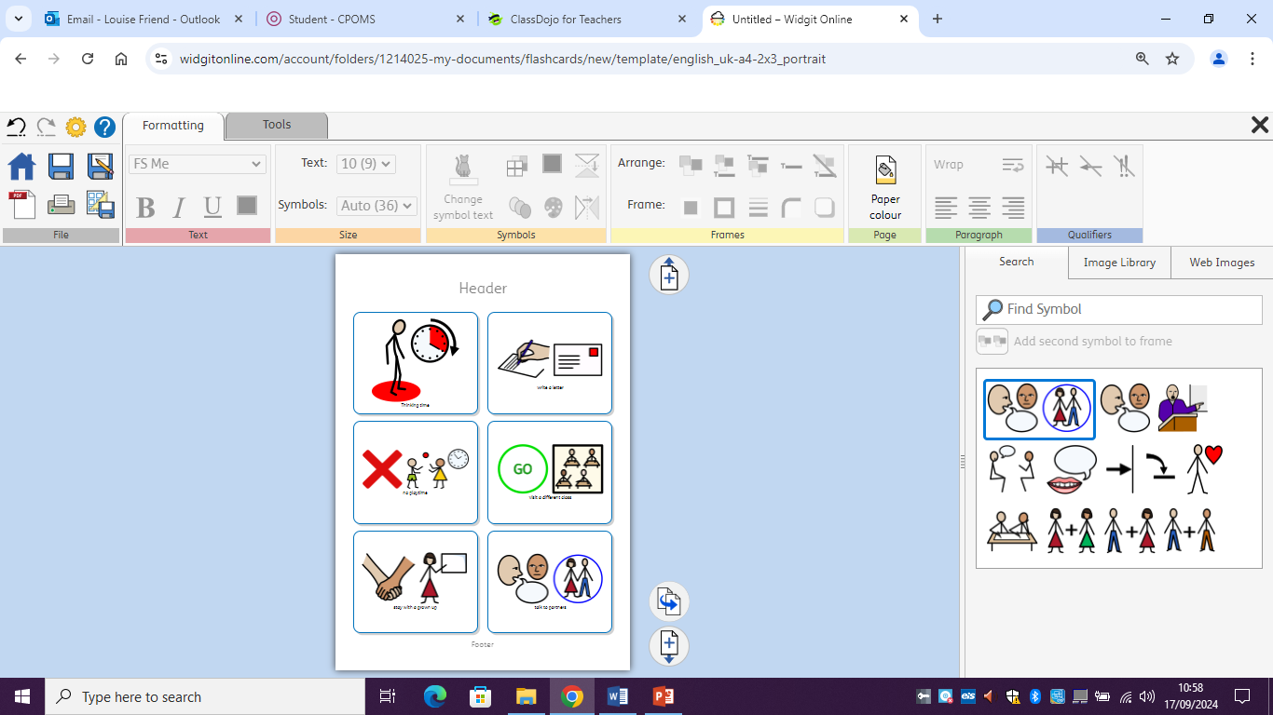
Talk to your partner:
If someone is being unkind/bullying another child, what could the consequences be?
Share these ideas with your teacher, who will share them with all the other adults in school.

Slide 13

We do not want bullying in our school. We want everyone to be safe, happy and able to learn.
We need a plan to make sure this happens…

Slide 14






At St Paul’s, everyone will:
Respect, think about and care for others
Talk about and celebrate
our differences
  Challenge people who do not follow these rules, or who
are being unkind
Use technology responsibly
and be safe online
Celebrate the successes and achievements for everyone,
even if they are different
to mine
Follow the rules and see
that we take bullying seriously.

Slide 15
Activity Ideas:
Put the consequences in order, from the least to the most serious.
What should you do if you are worried about bullying?
What would you do if you saw someone being unkind?

